Slide 1




Slide 2




Slide 3
Chapter Description

Slide 4




Slide 5



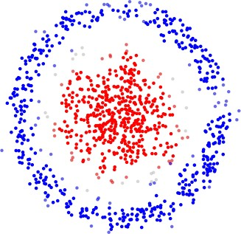
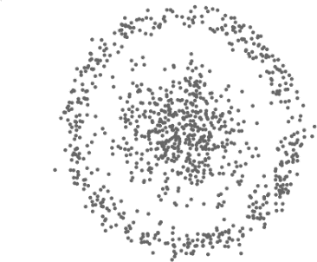
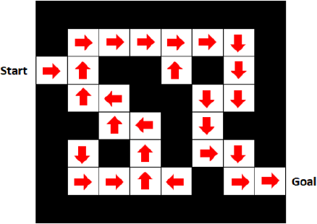


1.1. The Concept of Unsupervised Learning
UNIT 01

Slide 6
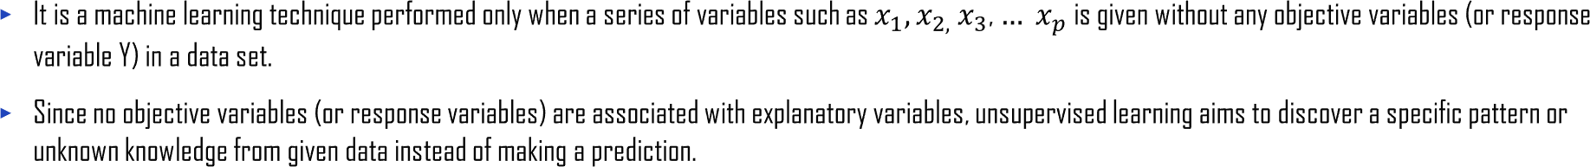
1.1. The Concept of Unsupervised Learning
UNIT 01

Slide 7
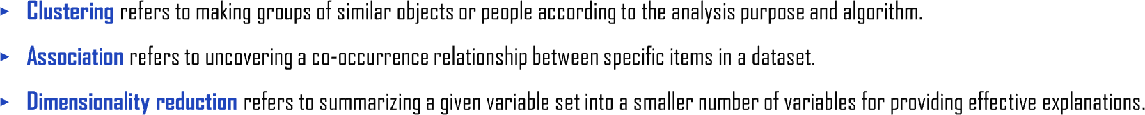
1.1. The Concept of Unsupervised Learning
UNIT 01

Slide 8


Slide 9
1.2. Clustering analysis
UNIT 01
How to classify customers with similar characteristics into the same cluster
Problem
Select clustering analysis type
Select clustering variables
Inducing groups of customers with similar characteristics
Analysis result
Cluster 1
Cluster 2
Cluster 3
Fragmentation of customers
Additional analysis on each cluster
Application 1
Application 1
Understand demographic, social, and physical characteristics of each customer group.
Make the group profile and understand their characteristics.
Understand the overall data distribution.
Additional analysis on each cluster

Slide 10

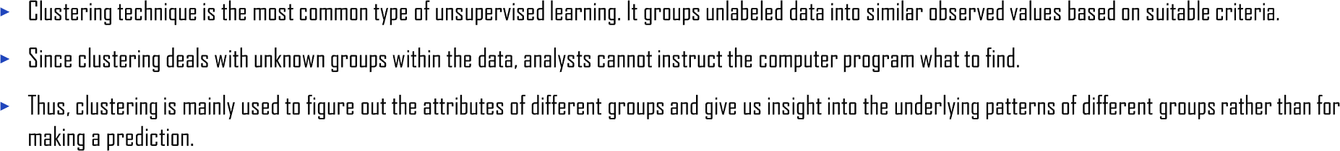
1.2. Clustering analysis
UNIT 01

Slide 11

1.2. Clustering analysis
UNIT 01
Clustering analysis
Hierarchical
Non-hierarchical
Single-linkage, complete-linkage, average- linkage,
center-based, Ward’s method
K-means, Kohonen network

Slide 12
1.2. Clustering analysis
UNIT 01
Non-Hierarchical Clustering (Partition-based Clustering) | K-means clustering
 | K-medoids clustering or PAM (Partitioning Around Method)
 | DBSCAN (Density Based Spatial Clustering of Application with Noise)
 | Self Organizing Map
 | Fuzzy clustering
Hierarchical Clustering | Agglomerative or bottom-up clustering
 | Divisive or top-down clustering
Mixture Distribution Clustering | Gaussian Mixture Model

Slide 13
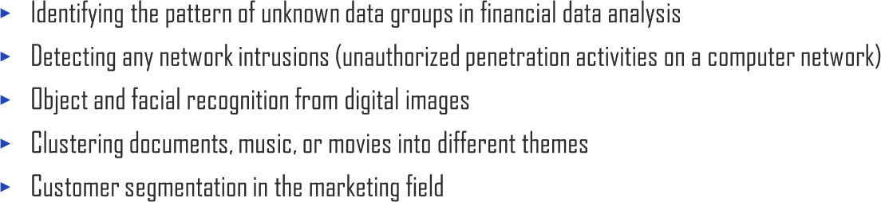
1.2. Clustering analysis
UNIT 01

Slide 14



Slide 15
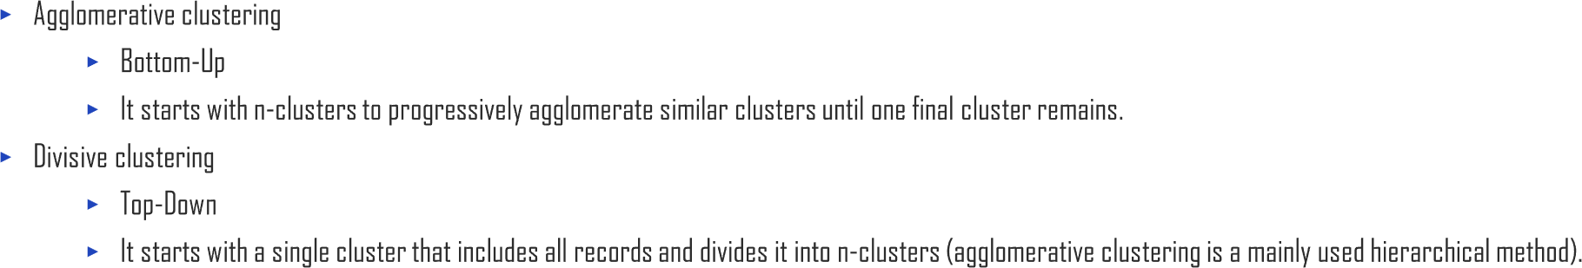
2.1. Hierarchical method
UNIT 02

Slide 16
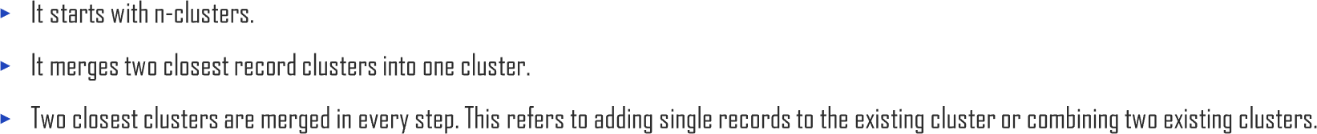
2.1. Hierarchical method
UNIT 02

Slide 17
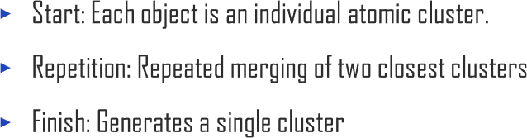
2.1. Hierarchical method
UNIT 02
6
5
X2
X2
X2
6
5
4
3
2
1
0
6
5
4
3
2
1
C
C
C
D F
E
D F
E
4
3
2
1
0
D F
E
A
B
A
B
B
X1
6
A
0
0
X2
2
4
0
2
4
6
X1
X1
0
2
4
6
X2
X2
6
5
4
3
2
1
0
6
5
4
3
2
1
0
6
C
C
C
5
4
3
2
1
D F
E
D F
E
D F
E
B
B
A
B
A
A
X1
6
0
2
4
6
X1
X1
0
0
2
4
0
2
4
6

Slide 18

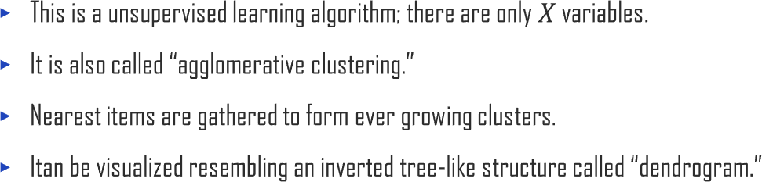
2.1. Hierarchical method
UNIT 02

Slide 19
2.1. Hierarchical method
UNIT 02

Slide 20
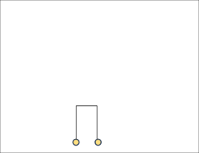
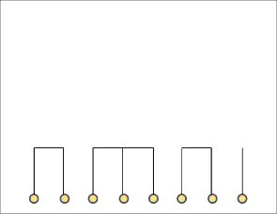
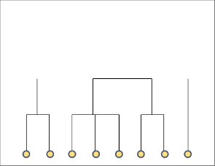
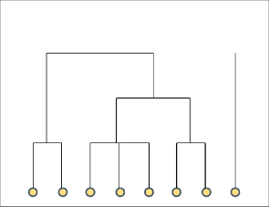
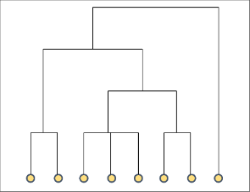
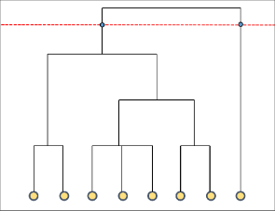




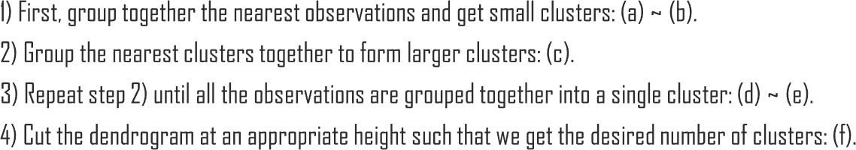
2.1. Hierarchical method
UNIT 02

Slide 21



2.1. Hierarchical method
UNIT 02

Slide 22
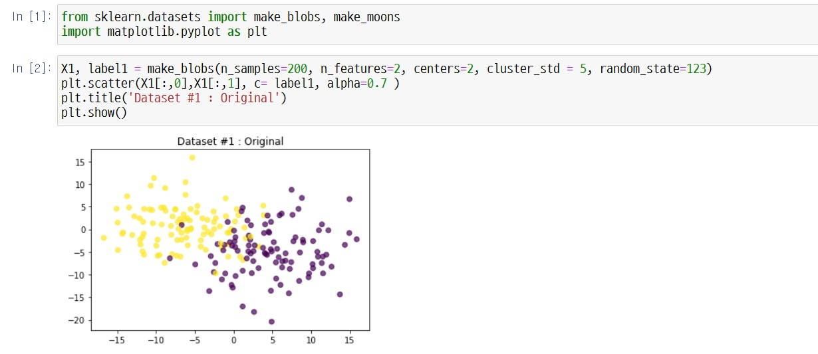
2.1. Hierarchical method
UNIT 02

Slide 23
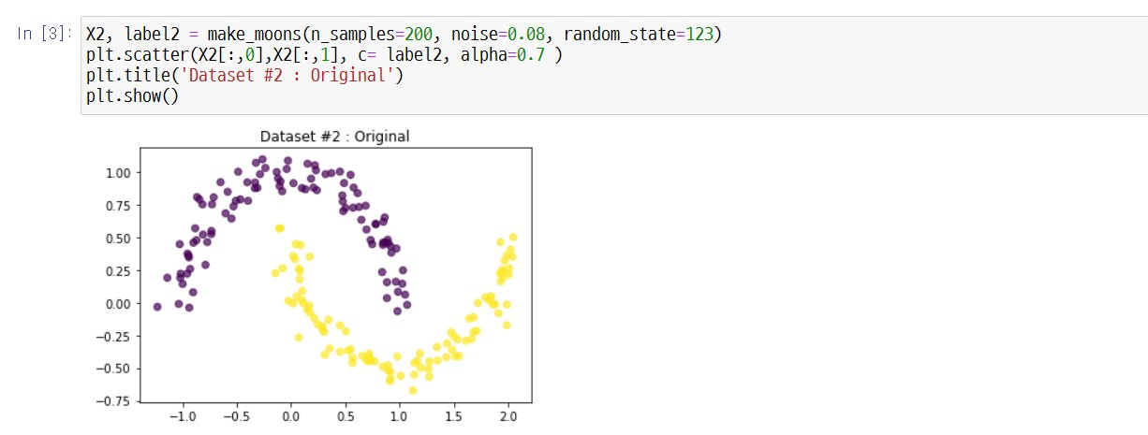
2.1. Hierarchical method
UNIT 02

Slide 24
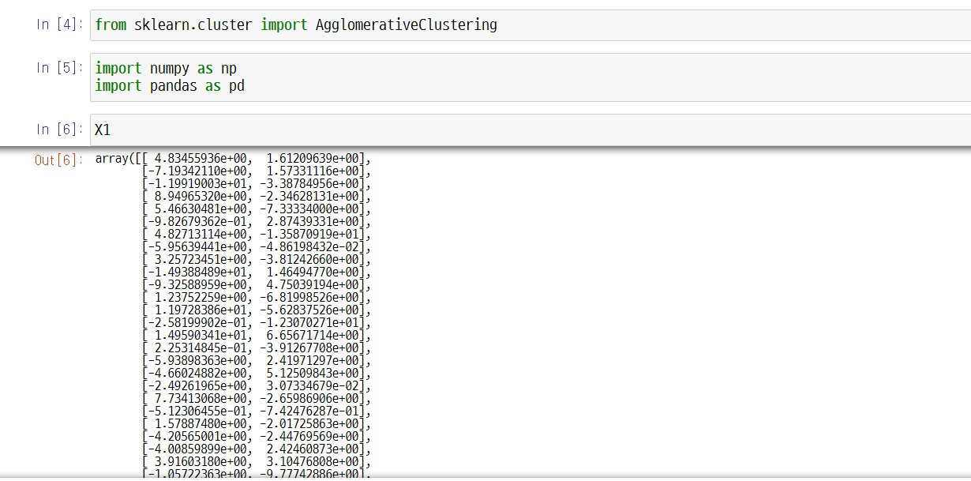
2.1. Hierarchical method
UNIT 02

Slide 25
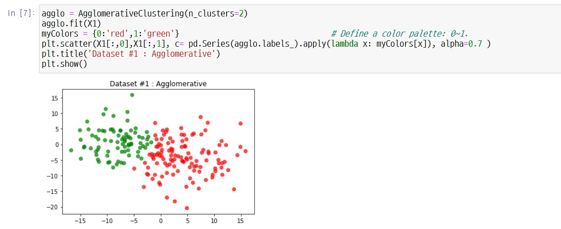
2.1. Hierarchical method
UNIT 02

Slide 26
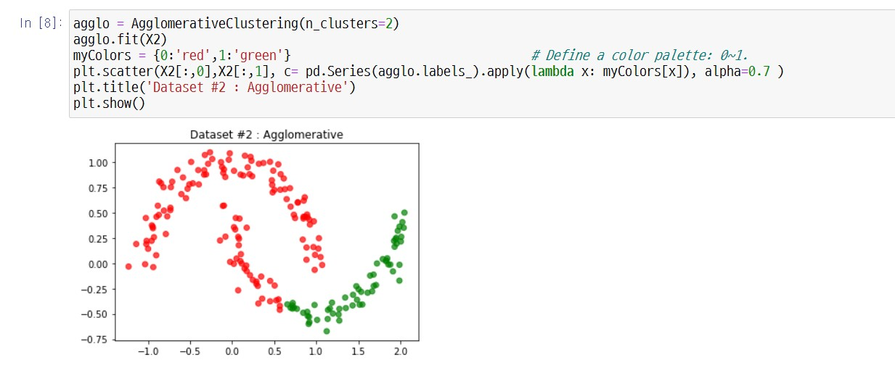
2.1. Hierarchical method
UNIT 02

Slide 27

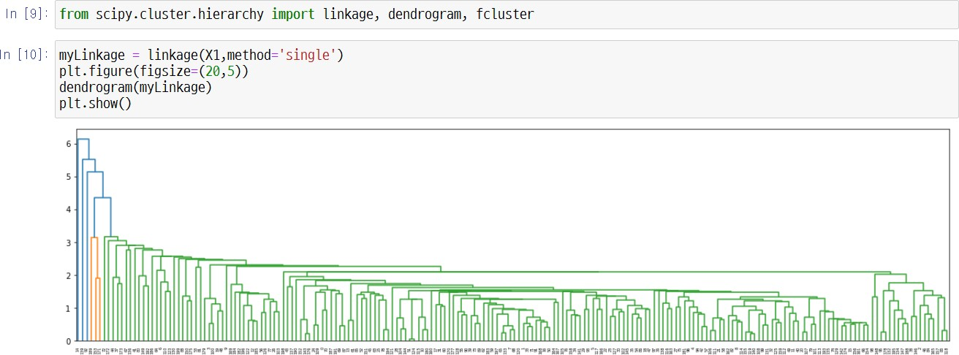
2.1. Hierarchical method
UNIT 02

Slide 28

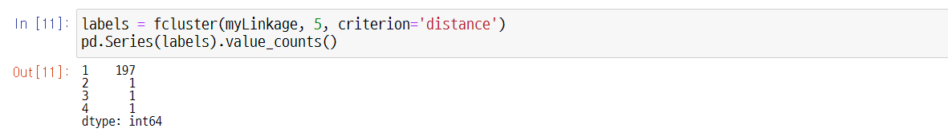
2.1. Hierarchical method
UNIT 02

Slide 29

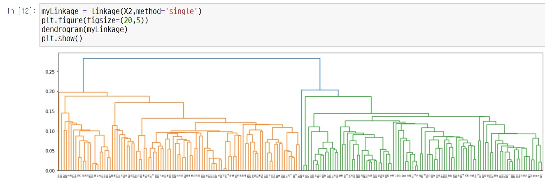
2.1. Hierarchical method
UNIT 02

Slide 30

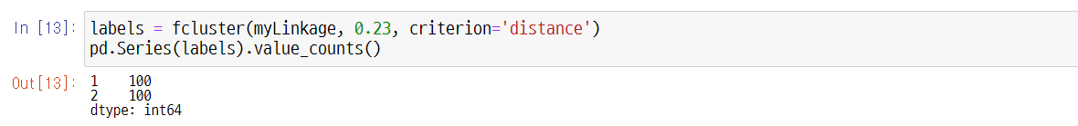
2.1. Hierarchical method
UNIT 02

Slide 31

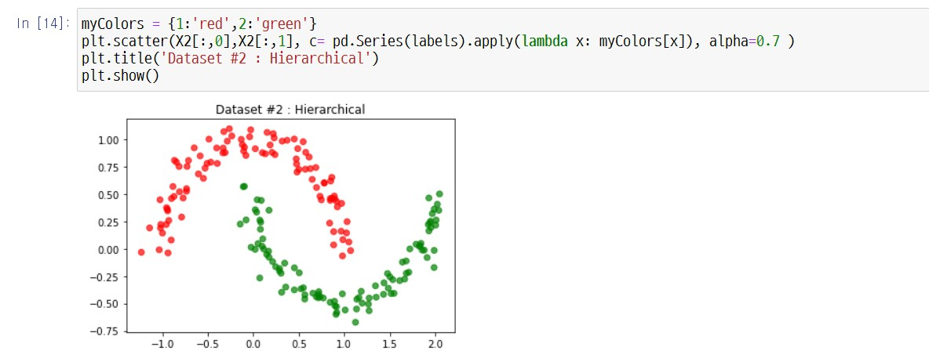
2.1. Hierarchical method
UNIT 02

Slide 32

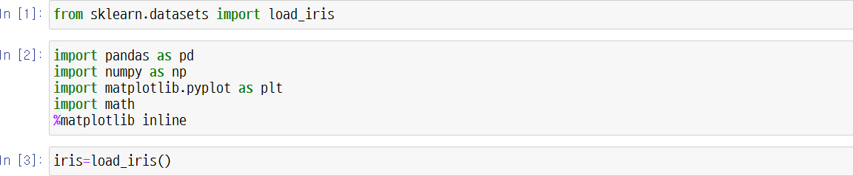
2.1. Hierarchical method
UNIT 02

Slide 33
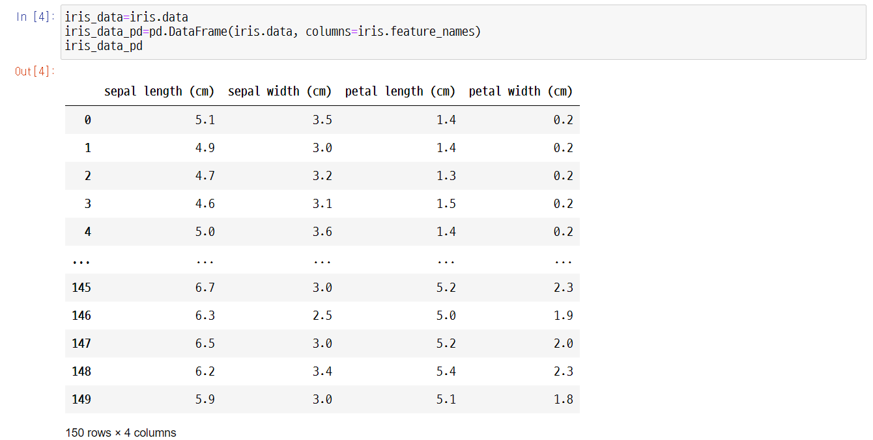
2.1. Hierarchical method
UNIT 02

Slide 34
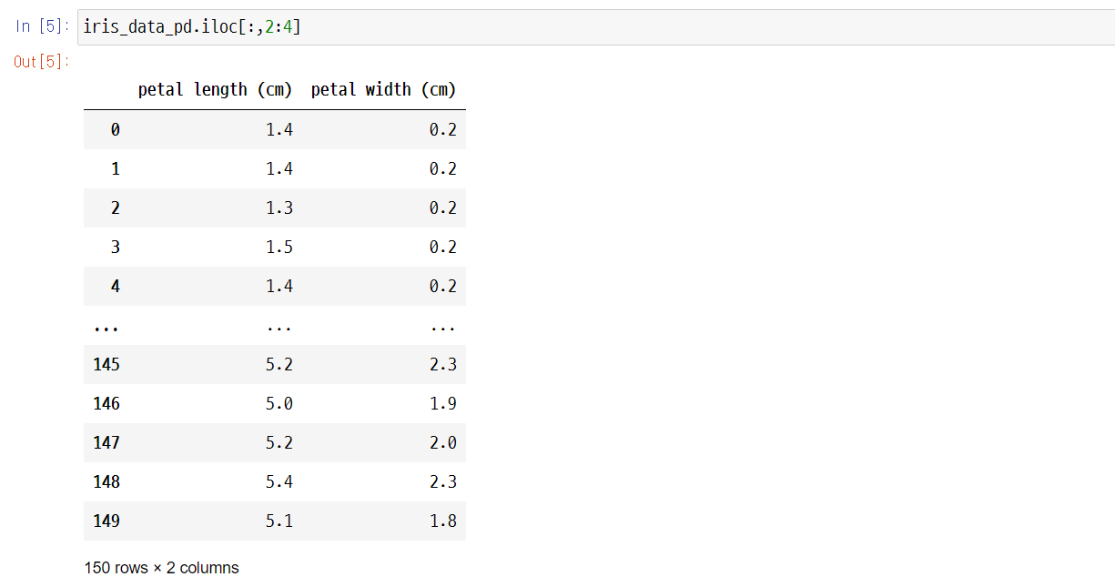
2.1. Hierarchical method
UNIT 02

Slide 35
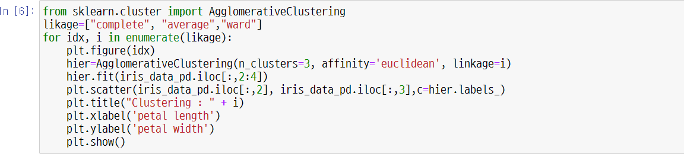
2.1. Hierarchical method
UNIT 02

Slide 36
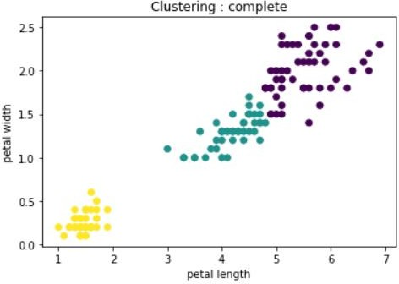
2.1. Hierarchical method
UNIT 02

Slide 37
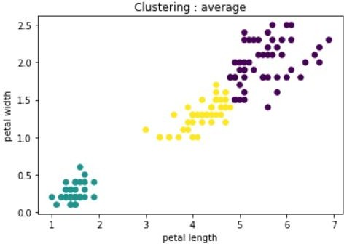
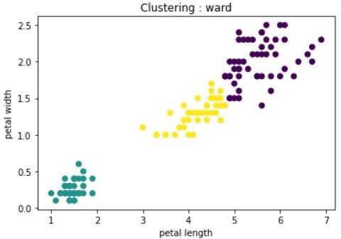
2.1. Hierarchical method
UNIT 02

Slide 38
2.1. Hierarchical method
UNIT 02

Slide 39
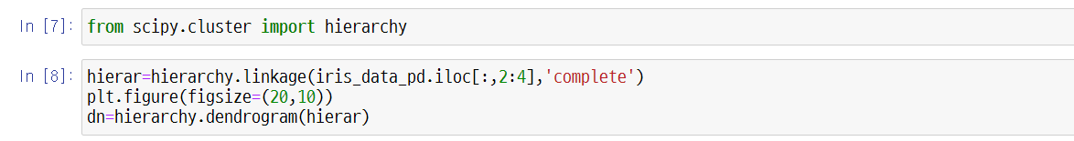
2.1. Hierarchical method
UNIT 02

Slide 40
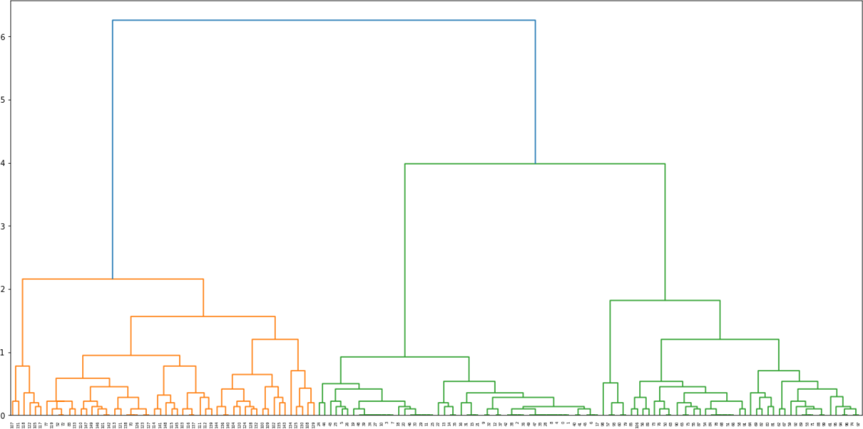
2.1. Hierarchical method
UNIT 02

Slide 41
2.1. Hierarchical method
UNIT 02

Slide 42
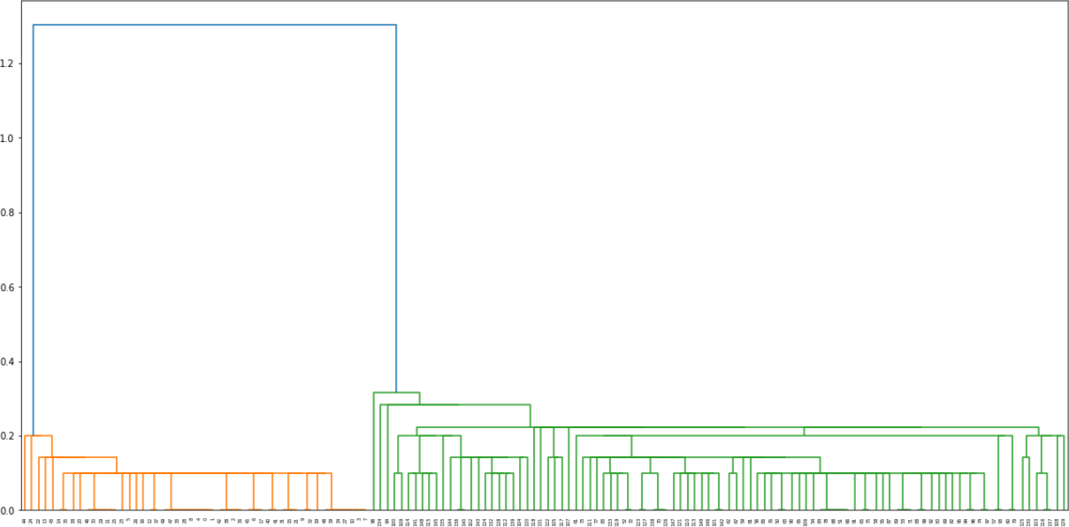
2.1. Hierarchical method
UNIT 02

Slide 43
2.1. Hierarchical method
UNIT 02

Slide 44




Slide 45



3.1. K-means clustering
UNIT 03

Slide 46
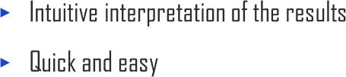
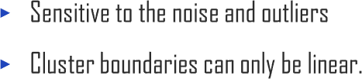
3.1. K-means clustering
UNIT 03

Slide 47
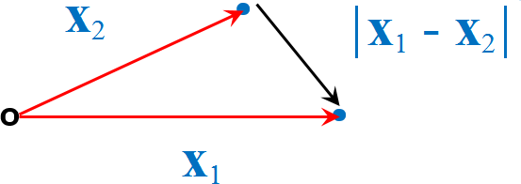
3.1. K-means clustering
UNIT 03

Slide 48
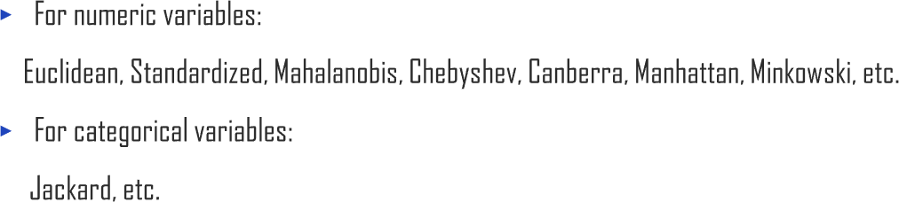

3.1. K-means clustering
UNIT 03

Slide 49

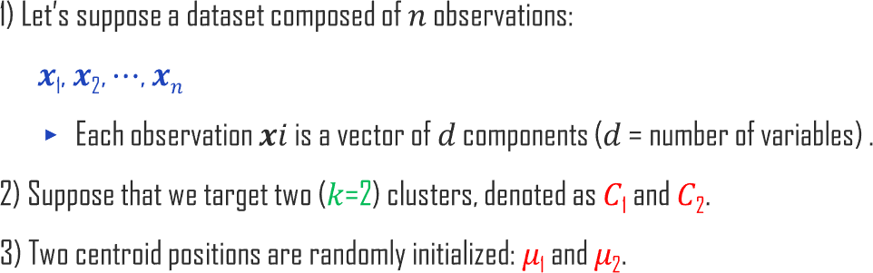
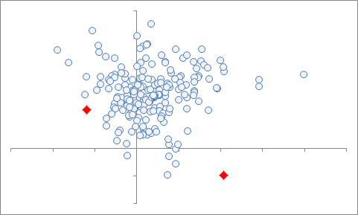
3.1. K-means clustering
UNIT 03

Slide 50
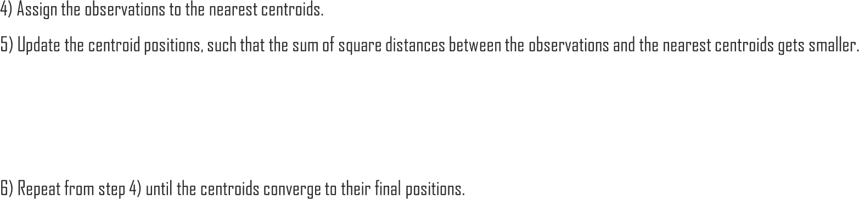
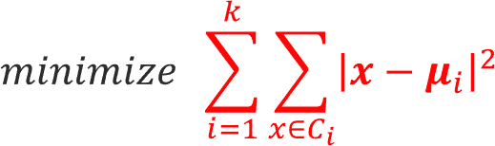
3.1. K-means clustering
UNIT 03

Slide 51
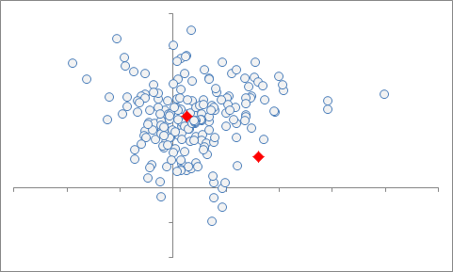
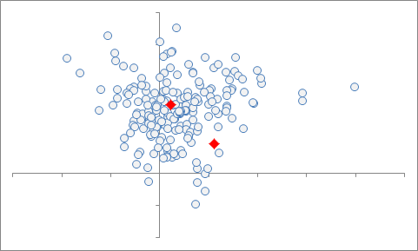
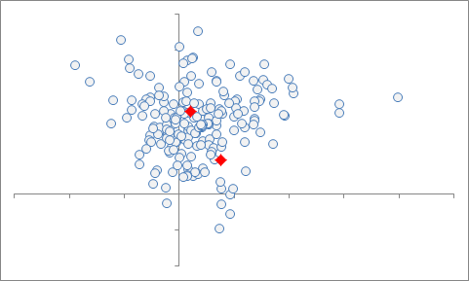




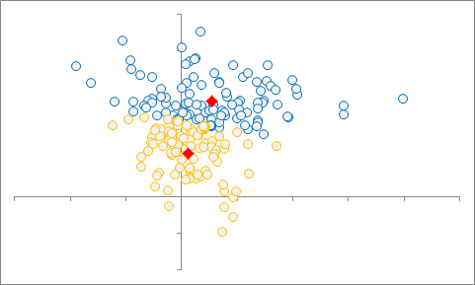





3.1. K-means clustering
UNIT 03

Slide 52




3.1. K-means clustering
UNIT 03

Slide 53


3.1. K-means clustering
UNIT 03

Slide 54

3.1. K-means clustering
UNIT 03

Slide 55


Slide 56

3.2. Other clustering methods
UNIT 03

Slide 57

3.2. Other clustering methods
UNIT 03

Slide 58


3.2. Other clustering methods
UNIT 03

Slide 59









3.2. Other clustering methods
UNIT 03

Slide 60

3.2. Other clustering methods
UNIT 03
P:5
𝜺

Slide 61

3.2. Other clustering methods
UNIT 03

Slide 62

3.2. Other clustering methods
UNIT 03
P=5

Slide 63

3.2. Other clustering methods
UNIT 03
P=5

Slide 64
3.2. Other clustering methods
UNIT 03
P=5

Slide 65


3.2. Other clustering methods
UNIT 03
P:5

Slide 66



3.2. Other clustering methods
UNIT 03

Slide 67

3.2. Other clustering methods
UNIT 03

Slide 68



Slide 69

4.1. Principal component Analysis
UNIT 04

Slide 70


4.1. Principal component Analysis
UNIT 04

Slide 71


4.1. Principal component Analysis
UNIT 04

Slide 72



4.1. Principal component Analysis
UNIT 04

Slide 73

4.1. Principal component Analysis
UNIT 04

Slide 74


4.1. Principal component Analysis
UNIT 04

Slide 75



4.1. Principal component Analysis
UNIT 04

Slide 76




4.1. Principal component Analysis
UNIT 04

Slide 77


4.1. Principal component Analysis
UNIT 04
Ex
“
”

Slide 78


4.1. Principal component Analysis
UNIT 04
𝑴
𝑸
𝜦
_{𝑸}𝒕
₌ m
⋅m
⋅m
m
m
m
m
m

Slide 79


4.1. Principal component Analysis
UNIT 04

Slide 80



4.1. Principal component Analysis
UNIT 04

Slide 81
4.1. Principal component Analysis
UNIT 04
𝑴
𝑼
𝜮
_{𝑽}𝒕
=
⋅ m
⋅ n
m
m
n
n
m
n

Slide 82


4.1. Principal component Analysis
UNIT 04

Slide 83



4.1. Principal component Analysis
UNIT 04

Slide 84





4.1. Principal component Analysis
UNIT 04

Slide 85

4.1. Principal component Analysis
UNIT 04

Slide 86





4.1. Principal component Analysis
UNIT 04

Slide 88



4.2. Applications of Principal Components
UNIT 04

Slide 89


4.2. Applications of Principal Components
UNIT 04

Slide 90
4.2. Applications of Principal Components
UNIT 04

Slide 91

4.2. Applications of Principal Components
UNIT 04

Slide 92
4.2. Applications of Principal Components
UNIT 04

Slide 93


4.2. Applications of Principal Components
UNIT 04

Slide 94


4.2. Applications of Principal Components
UNIT 04

Slide 95

4.2. Applications of Principal Components
UNIT 04

Slide 96



4.2. Applications of Principal Components
UNIT 04

Slide 97


4.2. Applications of Principal Components
UNIT 04

Slide 98




4.2. Applications of Principal Components
UNIT 04
Ex

Slide 99

4.2. Applications of Principal Components
UNIT 04

Slide 100



Slide 101


